Slide 1

Tricks & Tips for You and Your Student
UCF Society of Women Engineers
SWEet College Day 2018

Slide 2
Topics of this Workshop
Step-by-step guide for preparing in HS for college
Getting your student involved
Tests and their tricks
Scholarships
Florida’s Bright Futures Program
College and beyond…

Slide 3
About Tina
SWE President
Junior in Mechanical Engineering
Former Conference Chair
Summer Intern at the Naval Surface Warfare Center in Philadelphia, PA
Hobbies include attending concerts, playing basketball and softball

Slide 4
About Michaela
SWE Secretary
Junior in Computer Engineering
Former Outreach Chair
Summer Intern at General Electric in Melbourne, FL
Hobbies include kayaking, ice skating and playing with my cats

Slide 5
About Michaela
Junior in Computer Engineering
Former Outreach Chair, Current Secretary and Incoming President of SWE

Slide 6
Start Preparing NOW
It’s never too early to start preparing for college
College acceptances can be SUPER competitive
Learn how you can help your student stand out!
In essence, your student will eventually have to build a “college resume”

Slide 7
Start Talking About It
Talk with your guidance counselor about career options and the education required for those careers
Talk about saving and paying for college
Talk with friends, teachers, counselors and most importantly, your kids about college

Slide 8
Freshman and Sophomore Years
Participate in extracurricular activities and find niche
Explore internships and apprenticeships
Enroll in a summer enrichment program
Take the PSAT to prepare for the SAT (10th grade)
National Merit Scholarship opportunity
Start getting community service hours for Bright Futures

Slide 9
Florida’s Bright Futures Scholarship Program
Requirements:
Be a Florida resident and a U.S. citizen or eligible non-citizen
Earn a standard Florida high school diploma or equivalent
Be accepted by an eligible Florida public or independent postsecondary education institution, within 3 years of high school graduation
Be enrolled for at least 12 semester credit hours
Not have been found guilty of, or plead nolo contendere to, a felony charge
Apply for a scholarship from the program by high school graduation

Slide 10
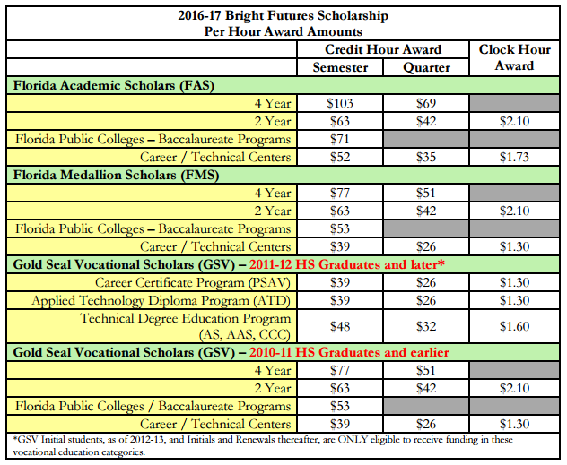
Award amounts:

Slide 11
Other Scholarships
Some schools automatically consider students for merit-based scholarships
Many website databases list scholarships for your students
Start applying for them early – most have deadlines associated with them
Fill out the FAFSA every year for your student to be qualified for government financial aid, grants, and fellowships

Slide 12
Junior Year
Attend college and financial aid fairs
Think about how your child’s college endeavors will be funded
Narrow down possible career options and investigate the type of education that is needed
Arrange campus visits to those schools that interest your child
Meet with an admissions officer, a financial aid representative, faculty members and college students

Slide 13
Junior Year
Encourage them to obtain officer positions in extracurricular activities they have been involved with
Consider earning college credit while in high school through Dual Enrollment, AP, IB and AICE programs
Saves money and time
Schedule to take the ACT and/or SAT in the Spring
Research private scholarship options
Continue to get community service hours

Slide 14
Tests
Colleges require your student to take either standardized test: SAT or ACT
Scores will be needed for each test and are a part of the admission decision
These tests are also important for scholarships and Florida’s Bright Futures Program

Slide 15
Tests
PSAT Sophomore Year
SAT/ACT end of Junior or summer/beginning of Senior Year
Advanced Placement Exams are taken each year at the completion of the AP class
Some consider these exams more difficult than college itself

Slide 16
Senior Year – The Big One!
Take or retake the ACT and/or SAT in the fall
Select the schools to which they will apply and have them make a list of important deadlines for each school
Continue to participate in extracurricular activities, sports, and community service
Admissions Counselors like continuity and leadership
Have your child create a resume of your academic, athletic and work activities as well as other achievements

Slide 17
Senior Year – The Big One!
Apply and DO NOT wait until just before the deadline
May need to request transcript from high school
Complete the Free Application for Federal Student Aid (FAFSA) as soon as possible after January 1
You must complete your taxes before submitting the FAFSA
Choose a college and send in any required forms or deposits (housing, meal plan, etc.)

Slide 18
College
Choosing the right college is up to you and your student
Look at their programs, especially if your student is interested in a particular field
Keep in mind the price of tuition, room & board, books, etc.
This can make a HUGE difference
Average in-state tuition for UCF is $2990 a semester (without room and board)

Slide 19
College
Which colleges are offering scholarships or grants?
What kind of job market supports the college?
UCF has major companies like: Harris, Lockheed Martin, Disney, Universal, Siemens, Boeing, etc. to support our school

Slide 20
Questions
Questions/Comments?
Information seen in this presentation will be available on the SWE @ UCF website
Contact Information:
SWE at UCF (swe.ucf@gmail.com)

Slide 21
Mentioned Opportunities
Opportunities similar to these can be easily found with a quick google search:
“high school internship opportunities”
GE Girls in Melbourne, FL
FIT section specifics can be found on Facebook
Northrop Grumman High School Internships in Melbourne, FL

Slide 22
Thanks for listening!
Enjoy SWEet College Day
Break until Lunch
Meet back in MSB 260

